Slide 1

Emerging Technologies
Transforming the Future through Innovation

Slide 2
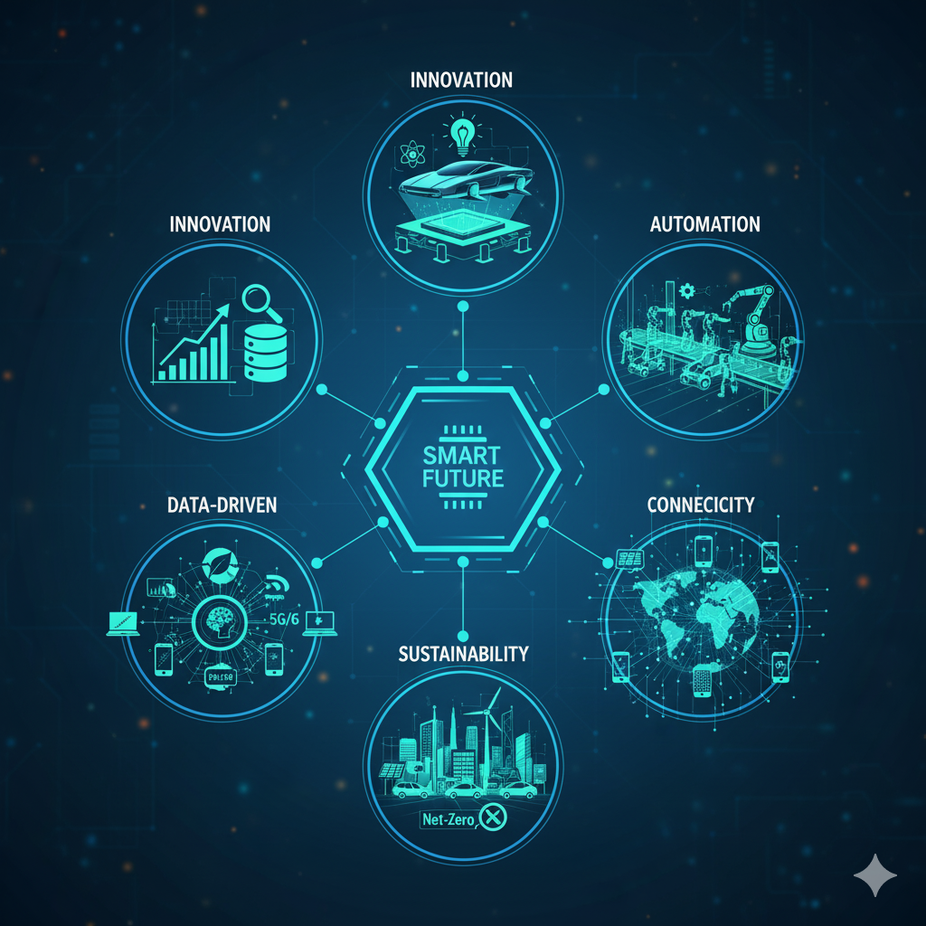
Definition
The world is entering a new digital era fueled by rapid innovation and technological advancement.
Emerging technologies are transforming how we live, learn, communicate, and work.
These innovations are making industries smarter, faster, and more connected.
They are influencing areas like healthcare, education, transportation, and business operations.

Slide 3
Artificial Intelligence (AI & Generative AI)
Definition: AI enables machines to think, learn, and act intelligently. Generative AI creates new content — like text, images, and designs — using deep learning.
Applications: ChatGPT, self-driving cars, healthcare diagnostics, predictive analytics.
Benefits: Automation, better decision-making, high accuracy, enhanced creativity.
Challenges: Ethical bias, data privacy issues, misuse risks, high costs.

Slide 4
Internet of Things (IoT)
Definition: Devices connected to the internet sharing real-time data.
Applications: Smart homes, wearables, healthcare, smart factories, connected cars.
Benefits: Real-time control, efficiency, better decision-making.
Challenges: Security, privacy, connectivity issues.

Slide 5
Some Emerging Key Technologies
Blockchain: Secure, decentralized digital transactions; applications in finance, supply chain.
5G Technology: Ultra-fast, low-latency wireless networks connecting devices globally.
Augmented & Virtual Reality (AR/VR): Immersive experiences for gaming, education, and training.
Quantum Computing: Ultra-powerful computing solving complex problems faster than classical computers.
Robotics & Automation: Smart machines improving manufacturing, healthcare, and daily life.
Biotechnology: Genetic engineering, medical advancements, and sustainable solutions.

Slide 6



Benefits
Increased Efficiency & Productivity – Automation reduces human effort.
Better Decision-Making – AI and data analytics provide smart insights.
Improved Connectivity – 5G and IoT link people, devices, and systems.
Enhanced Customer Experience – Personalized and interactive services.
Sustainability – Green computing and smarter energy management.

Slide 7
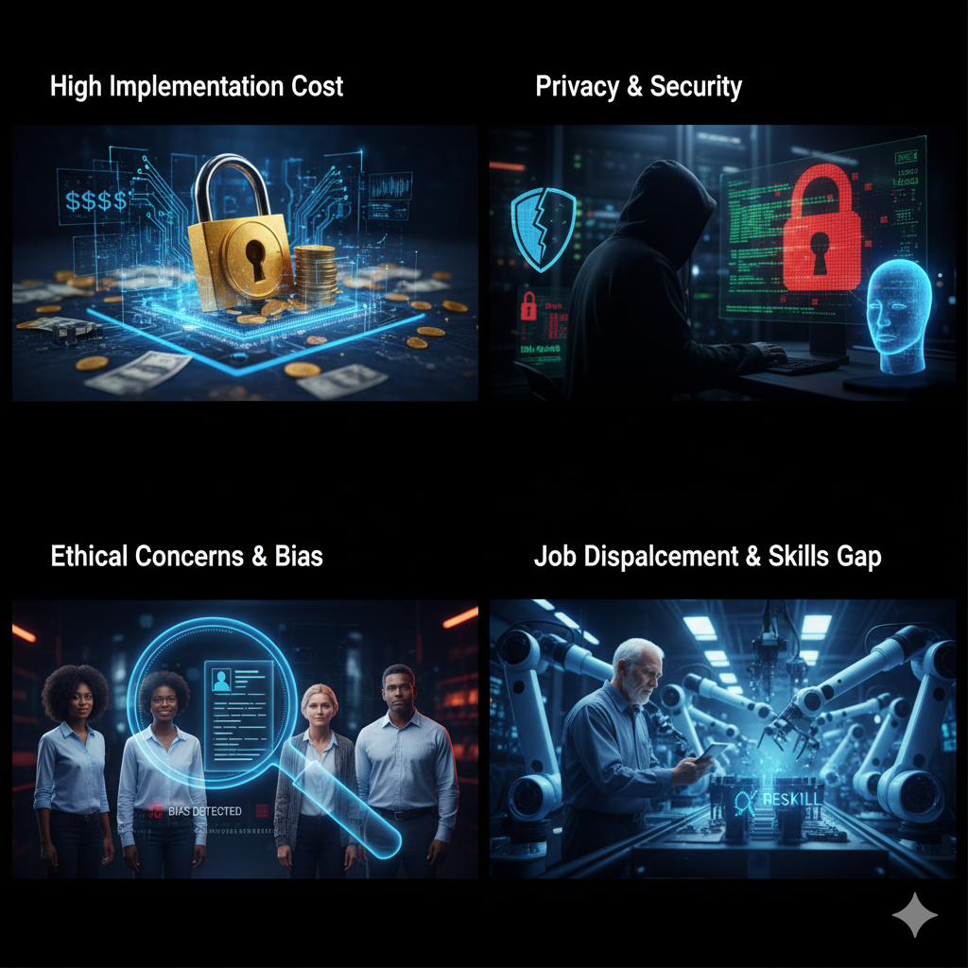
Challenges
Data Privacy & Security Risks – Sensitive data can be hacked or misused.
High Implementation Costs – Advanced technologies require significant investment.
Ethical Concerns & Bias – AI and automation can introduce unfair decisions.
Skill Gap – Need for trained professionals to operate and manage technologies.

Slide 8
Future Scope
Continuous Innovation and Adoption - Technologies will keep evolving, leading to smarter solutions and increased adoption across sectors.
Integration of Multiple Emerging Technologies - Combining AI, IoT, blockchain, and AR/VR can create more powerful, integrated systems.
More Sustainable and Intelligent Systems - Focus on eco-friendly solutions like renewable energy, smart cities, and sustainable manufacturing like Green computing.

Slide 9

Conclusion
“Technology is a useful servant but a dangerous master.” — Christian Lous Lange
Emerging technologies are reshaping industries, economies, and daily life at an unprecedented pace.
They provide immense potential to improve overall quality of life.

